Slide 1
Customer Review Data
Topic Modelling & Sentiment Analysis

Slide 2
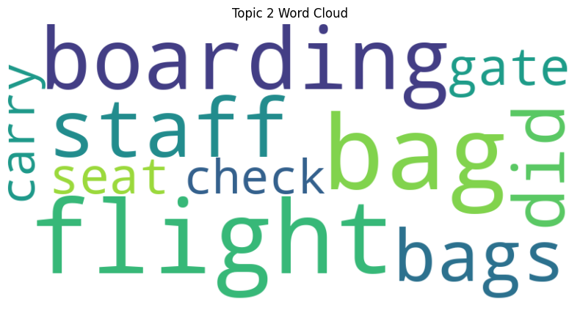
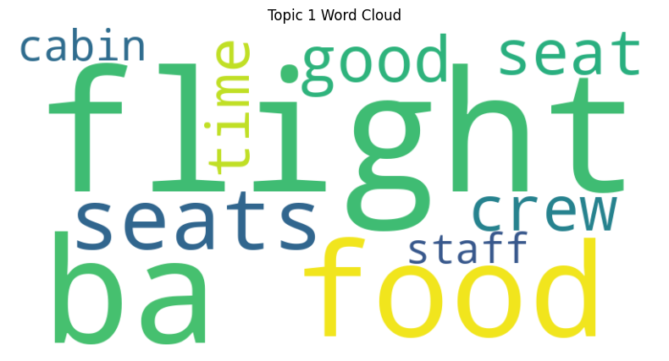
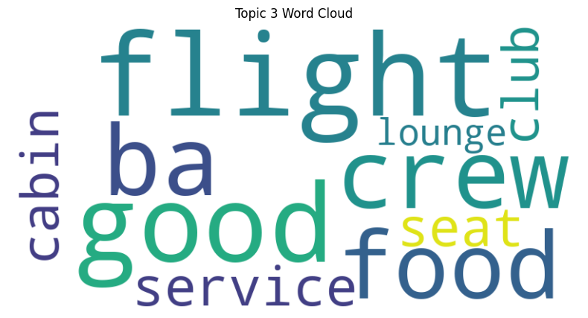
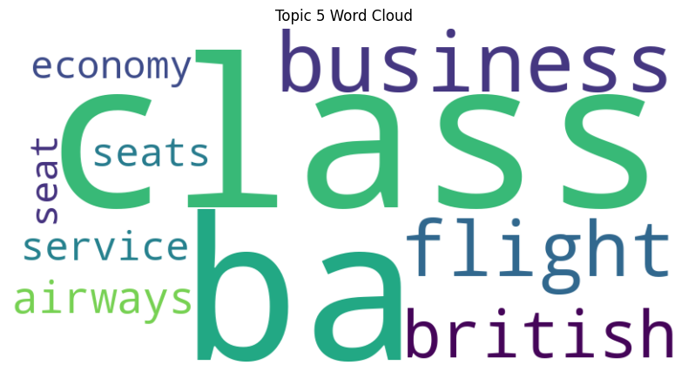
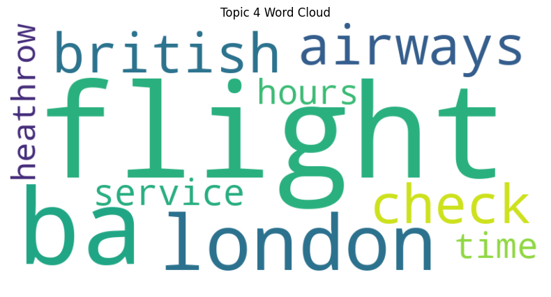
Topic Modeling
Skytrax reviews of British Airways highlight flight experience, seating, crew service, boarding, baggage, in-flight service quality, and amenities. London Heathrow Airport’s efficiency and travel classes like economy and business are also frequently discussed.

Slide 3
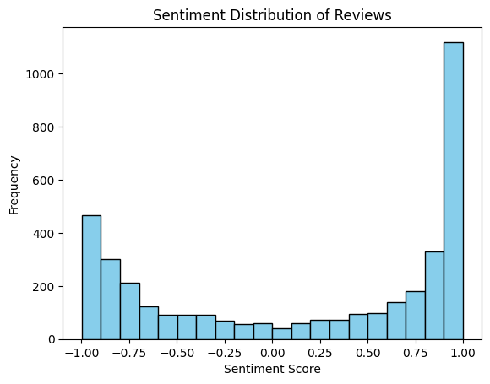
Sentiment Analysis
The sentiment analysis graph for British Airways on Skytrax shows a predominance of positive reviews, with the most frequent sentiment score being +1. Negative reviews are present too, notably at scores of -0.75 and -1. This indicates a general positive trend, despite a diversity of customer experiences.

